Slide 1
MassMutual DSDP 2018: Visualization Techniques
June 18, 2018
R. Jordan Crouser
Assistant Professor of Computer Science
Smith College

Slide 2
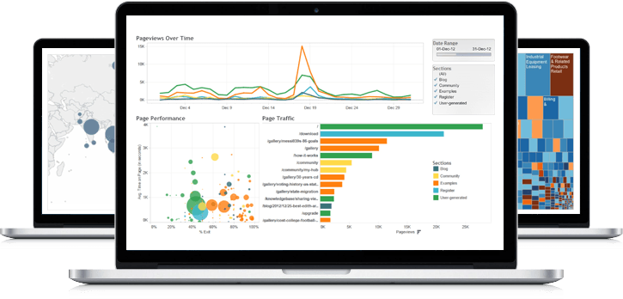
What visualization techniques do you know?

Slide 3
Bar chart
Used for comparable variables
Compares quantitative values for different categories
Highlights relative amounts
Grouped/stacked bars can break each category into sub-groups

Slide 4
Histogram
Looks like a bar chart… but the x-axis is continuous
Y-axis shows count or relative frequency
Highlights distribution
Note: bin size makes a big difference!

Slide 5
Boxplot
Also useful for highlighting distribution
Calls out key values:
median
1st & 3rd quartiles
“fences”
outliers
“fence”
(1.5IQR)
3rd
quartile
outlier
median
1st
quartile

Slide 6
Boxplot add-ons
Use “jitter” to show actual values
Reference lines can help provide context
Can use annotations to show statistical significance

Slide 7
Scatterplot
Shows the relationship between two continuous variables
Each point in the plot represents an observation
You can change color or symbol to highlight groups
Sometimes useful to show a trend line (regression)

Slide 8
Scatterplot matrix (SPLOM)
Scatterplots show the relationship between just two continuous variables at a time
We can combine multiple scatterplots into a matrix to show additional relationships

Slide 9
Line chart
Shows the trend in one variable, often over time
Multiple lines can show multiple variables, or the same variable for multiple observations (must have the same scale!)
Highlights “position switches”

Slide 10
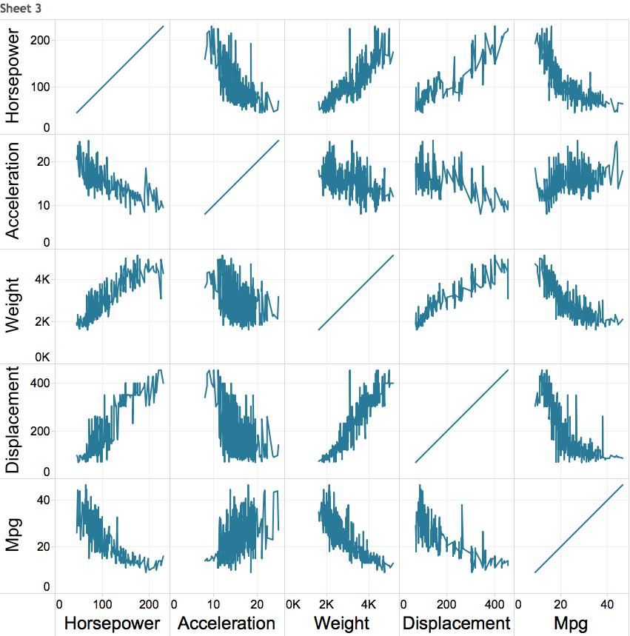
Multiple variables: line chart matrix?

Slide 11
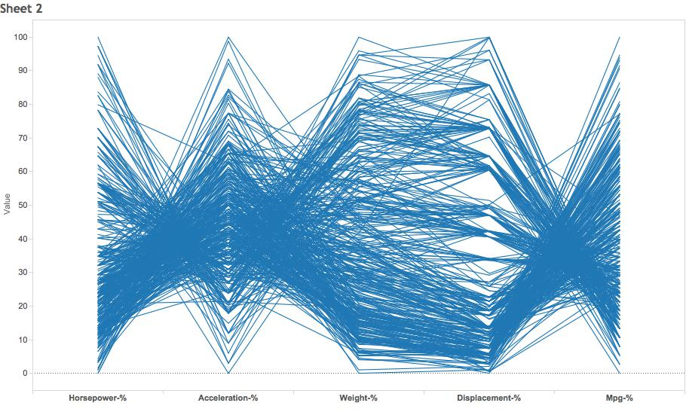
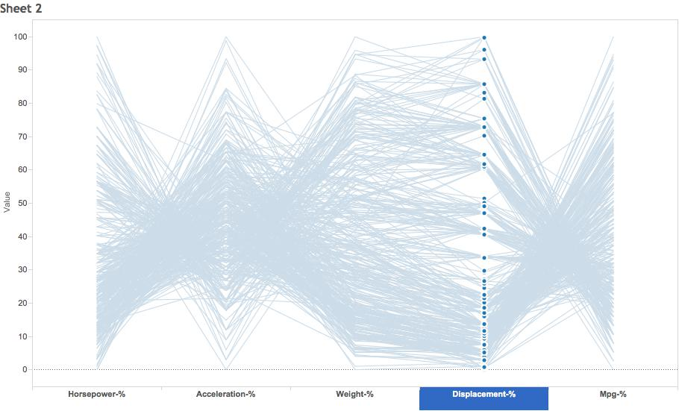
Weirder idea
H A W D M
“parallel coordinates plot”

Slide 12
Morning challenge
H A W D M
“parallel coordinates plot”
How would you build this using ggplot2?

